Slide 1
Comparing Fractions Game

Slide 2
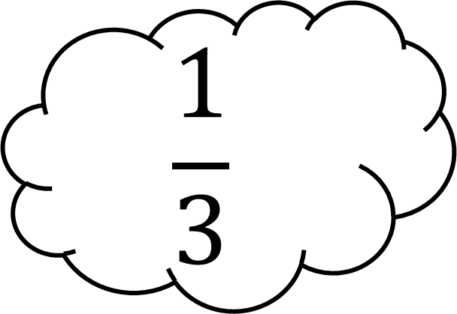
Which fraction is bigger?
$$\frac{1}{4}$$
$$\frac{1}{3}$$

Slide 3
Which fraction is bigger?
$$\frac{2}{3}$$
$$\frac{3}{6}$$

Slide 4
Which fraction is bigger?
$$\frac{4}{5}$$
$$\frac{3}{4}$$

Slide 5
Which fraction is bigger?
$$\frac{2}{5}$$
$$\frac{1}{3}$$

Slide 6
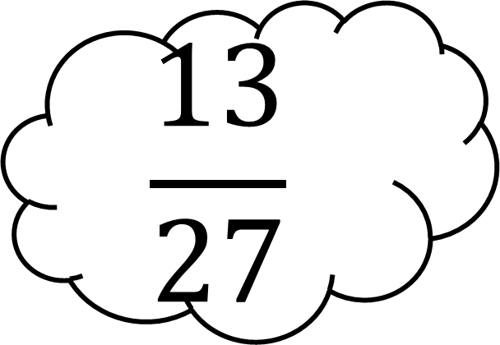
Which fraction is bigger?
$$\frac{6}{9}$$
$$\frac{13}{27}$$

Slide 7
Which fraction is bigger?
$$\frac{2}{6}$$
$$\frac{3}{4}$$

Slide 8
Which fraction is bigger?
$$\frac{4}{8}$$
$$\frac{4}{6}$$

Slide 9
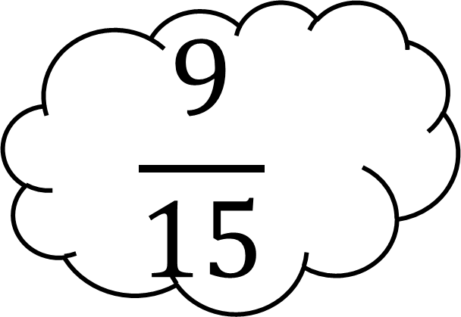
Which fraction is bigger?
$$\frac{9}{15}$$
$$\frac{1}{3}$$

Slide 10
Which fraction is bigger?
$$\frac{2}{11}$$
$$\frac{3}{5}$$

Slide 11
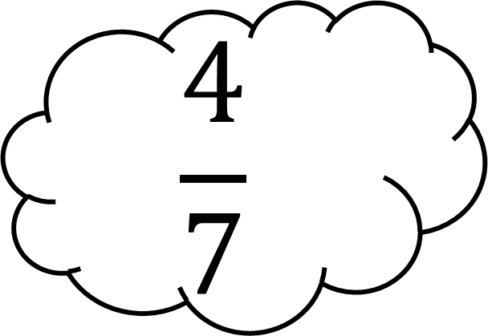
Which fraction is bigger?
$$\frac{4}{7}$$
$$\frac{5}{8}$$

Slide 12
Which fraction is bigger?
$$\frac{3}{7}$$
$$\frac{2}{6}$$

Slide 13
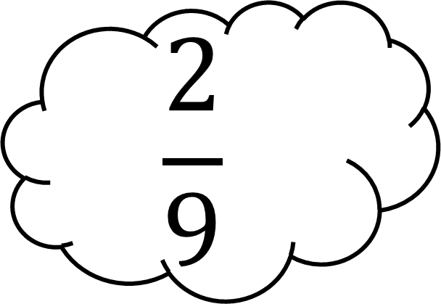
Which fraction is bigger?
$$\frac{2}{9}$$
$$\frac{2}{8}$$

Slide 14
Which fraction is bigger?
$$\frac{3}{12}$$
$$\frac{2}{16}$$

Slide 15
Which fraction is bigger?
$$\frac{4}{14}$$
$$\frac{1}{4}$$

